Slide 1
Making Kubectl PowerShell Friendly
The PoSh Wolf
https://github.com/theposhwolf/sessions

Slide 2
Pronunciation

Slide 3
Who is The PoSh Wolf?
Anthony Howell
From Eugene, OR USA so, according to ChatGPT, I am:
Progressive, outdoorsy, creative, friendly, and open-minded
~3.3 kids, 2 dogs, 1 wife, 1 cat
In IT since 2011
Blogger (https://theposhwolf.com)
Twitter (https://twitter.com/theposhwolf)
Pluralsight author (https://pluralsight.com)
Consulting (https://howell-it.com)
Employed (Cloud Platform Architect)

Slide 4
Fun Fact

Slide 5
Picture

Slide 6
Overview
What is the problem?
Why not Crescendo or -o json?
What does the solution require?
Technical solution - Parsing output
Gotchas
Technical solution - Generating PowerShell formats
Reducing reliance on Where-Object (Filtering Left)

Slide 7

The Problem
Kubectl is just stdout

Slide 8
Crescendo?

Slide 9
No
More PowerShelly
Not cross-shell compatible
Learning a crescendo version of a industry standard tool is a waste of time. Do not do that!

Slide 10


Slide 11
-o json | ConvertFrom-Json?

Slide 12
No
Too much typing
Differently structured data

Slide 14
Solution Requirements
Output Objects
Preserve syntax
Preserve output format
Keep it reliable and efficient

Slide 15
Kubectl that outputs objects

Slide 16
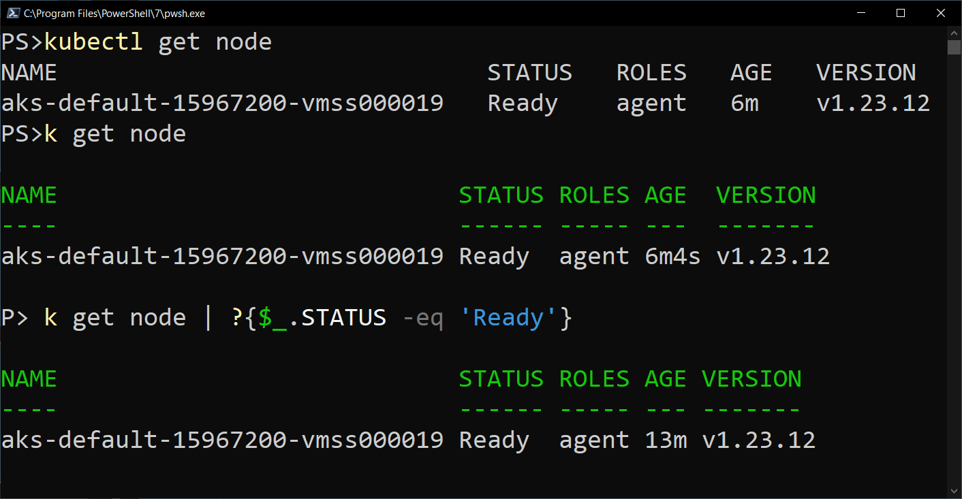
My Solution

Slide 17
Prerequisites
PowerShell 7+
Kubectl

Slide 18
Demo Environment
Windows 10
VS Code (latest version)
PowerShell 7.3.4
specialK
Kubectl
Kubernetes on Docker

Slide 19
Parsing

Slide 20
Process
Use headers to calculate spacing indexes
Insert semicolons
ConvertFrom-CSV –Delimiter ‘;’
Insert type name (for format)

Slide 21
NAME READY STATUS RESTARTS AGE
database-deployment-194a92db12-b2aat 1/1 Running 0 10d
web-deployment-98ad9380dd-8brg3 1/1 Running 0 2d7h

Slide 22
NAME ;READY ;STATUS ;RESTARTS ;AGE
database-deployment-194a92db12-b2aat ;1/1 ;Running ;0 ;10d
web-deployment-98ad9380dd-8brg3 ;1/1 ;Running ;0 ;2d7h

Slide 23
NAME;READY;STATUS;RESTARTS;AGE
database-deployment-194a92db12-b2aat;1/1;Running;0;10d
web-deployment-98ad9380dd-8brg3;1/1;Running;0;2d7h

Slide 24
Parsing code walkthrough, including gotchas

Slide 25
Formats

Slide 26
Formats walkthrough

Slide 27
Filtering Left

Slide 28
Filtering Left Demo

Slide 29
github.com/theposhwolf/specialk
Also available on the PowerShell Gallery

Slide 30
Questions?

